Slide 1
Pyrrha
Horace Odes I : 5

Slide 2
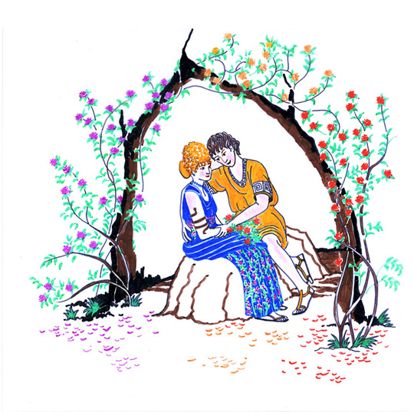
Horace Odes I : 5 read by Helen and Sophia on www.pyrrha.me.uk
quis multa gracilis te puer in rosa
perfusus liquidis urget odoribus
grato, Pyrrha, sub antro?
cui flavam religas comam,
simplex munditiis? heu quotiens fidem
mutatosque deos flebit et aspera
nigris aequora ventis
emirabitur insolens,
qui nunc te fruitur credulus aurea,
qui semper vacuam, semper amabilem
sperat, nescius aurae
fallacis. miseri, quibus
intemptata nites. me tabula sacer
votiva paries indicat uvida
suspendisse potenti
vestimenta maris deo.
Which slender boy, drenched in liquid perfume,
Presses against you amongst the many roses
In your pleasant love nest, Pyrrha?
For whom do you tie up your blonde hair
Simplistic in your elegance? Alas, how often will he weep,
Inexperienced, at trustworthiness and the changed fates,
And be amazed at seas,
Rough with black winds.
He, in naivety, is now enjoying you, his golden one.
He hopes you will always be free for him, always loving,
Unaware of the treacherous breezes!
O wretches, for whom you
Yet untried, gleam. As for me,
The holy wall shows, with its votive tablet,
That I have hung up my soaking wet clothes
To the powerful God of the sea.
Translation by Helen

Slide 3
quis multa gracilis te puer in rosa
perfusus liquidis urget odoribus
grato, Pyrrha, sub antro?
See how the picture builds up as we look at the
words one at a time.

Slide 4

quis
So we know the first sentence is a question: who is the subject?

Slide 5
quis multa

Slide 6
quis multa gracilis
‘gracilis’ agrees with ‘quis’ – so we have a graceful question-mark!

Slide 7
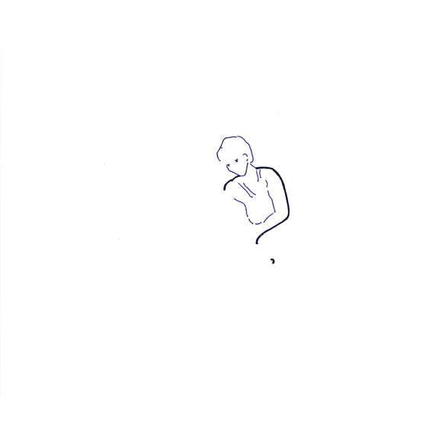
quis multa gracilis

Slide 8
quis multa gracilis te
Another person is introduced – but we don’t know the sex of either

Slide 9
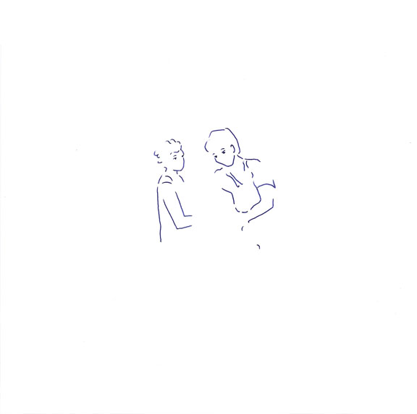
quis multa gracilis te

Slide 10
quis multa gracilis te puer
Now we know the graceful question-mark is masculine – a young boy

Slide 11
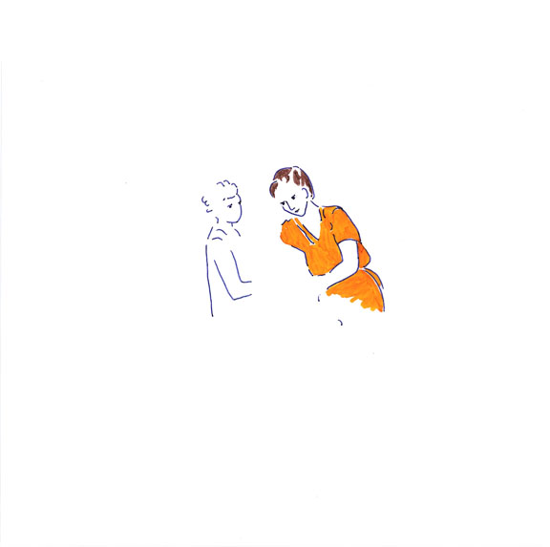
quis multa gracilis te puer

Slide 12
quis multa gracilis te puer in rosa
‘multa’ must agree with the roses – lots of them

Slide 13
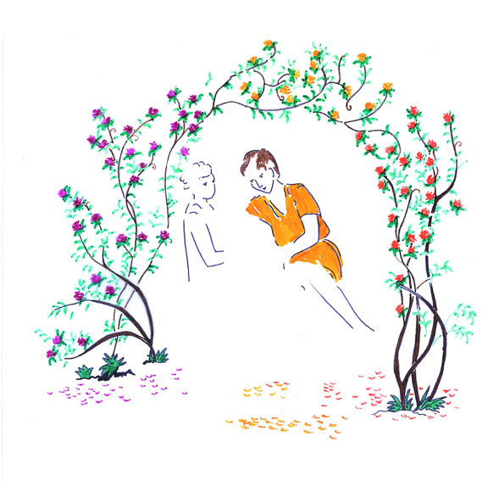
quis multa gracilis te puer in rosa

Slide 14
quis multa gracilis te puer in rosa
perfusus
the young boy is drenched …

Slide 15
quis multa gracilis te puer in rosa
perfusus liquidis

Slide 16
quis multa gracilis te puer in rosa
perfusus liquidis urget
something is going on! We can at least move the figures closer together

Slide 17
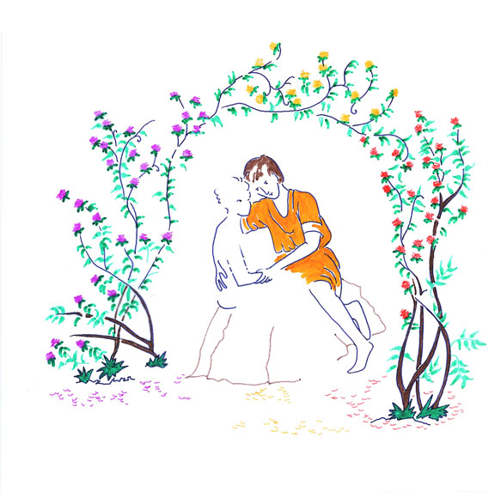
quis multa gracilis te puer in rosa
perfusus liquidis urget

Slide 18
quis multa gracilis te puer in rosa
perfusus liquidis urget odoribus

Slide 19
Drenched in perfume? Has this young lad overdone the aftershave?
‘puer’ is a surprising choice of word if we are looking at a love scene: a boy of under 12 (or even a slave)
quis multa gracilis te puer in rosa
perfusus liquidis urget odoribus

Slide 20
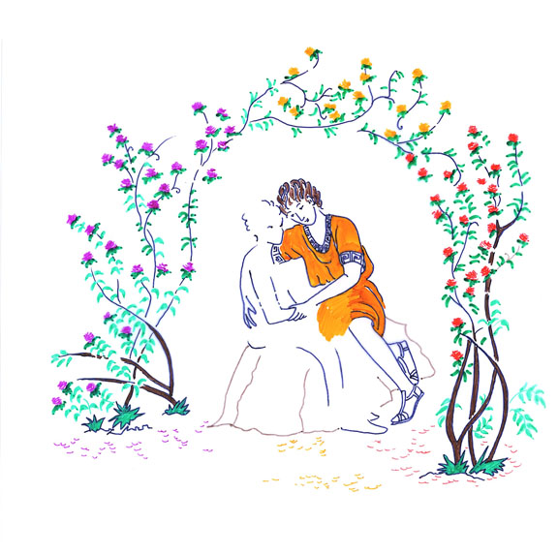
quis multa gracilis te puer in rosa
perfusus liquidis urget odoribus

Slide 21
quis multa gracilis te puer in rosa
perfusus liquidis urget odoribus
grato,

Slide 22
quis multa gracilis te puer in rosa
perfusus liquidis urget odoribus
grato, Pyrrha,
The second person has a name!

Slide 23
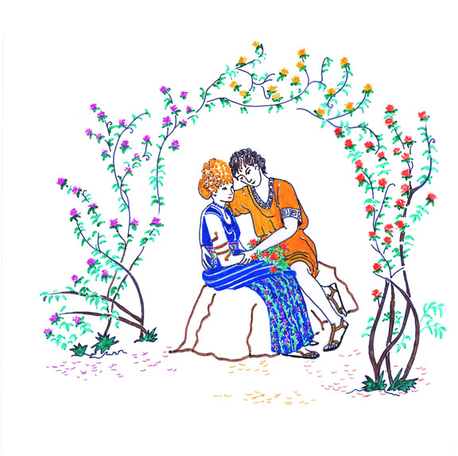
quis multa gracilis te puer in rosa
perfusus liquidis urget odoribus
grato, Pyrrha,

Slide 24
quis multa gracilis te puer in rosa
perfusus liquidis urget odoribus
grato, Pyrrha, sub antro
‘grato’ refers to a little cave
(or recessed bed?)

Slide 25
quis multa gracilis te puer in rosa
perfusus liquidis urget odoribus
grato, Pyrrha, sub antro.

Slide 27
A reading of the whole poem gives an interesting character-study of Pyrrha, more insight into the puer’s situation and a humorous view of Horace’s own view of love, which some commentators like to see as autobiographical.

Slide 28
Horace Odes I : 5
quis multa gracilis te puer in rosa
perfusus liquidis urget odoribus
grato, Pyrrha, sub antro?
cui flavam religas comam,
simplex munditiis? heu quotiens fidem
mutatosque deos flebit et aspera
nigris aequora ventis
emirabitur insolens,
qui nunc te fruitur credulus aurea,
qui semper vacuam, semper amabilem
sperat, nescius aurae
fallacis. miseri, quibus
intemptata nites. me tabula sacer
votiva paries indicat uvida
suspendisse potenti
vestimenta maris deo.
Which slender boy, drenched in liquid perfume,
Presses against you amongst the many roses
In your pleasant love nest, Pyrrha?
For whom do you tie up your blonde hair
Simplistic in your elegance? Alas, how often will he weep,
Inexperienced, at trustworthiness and the changed fates,
And be amazed at seas,
Rough with black winds.
He, in naivety, is now enjoying you, his golden one.
He hopes you will always be free for him, always loving,
Unaware of the treacherous breezes!
O wretches, for whom you
Yet untried, gleam. As for me,
The holy wall shows, with its votive tablet,
That I have hung up my soaking wet clothes
To the powerful God of the sea.
Translation by Helen

Slide 29
quis multa gracilis te puer in rosa
perfusus liquidis urget odoribus
grato, Pyrrha, sub antro?
Now look at the words in the first three lines:
Who is the most important person, and where are the words
describing this person positioned?

Slide 30
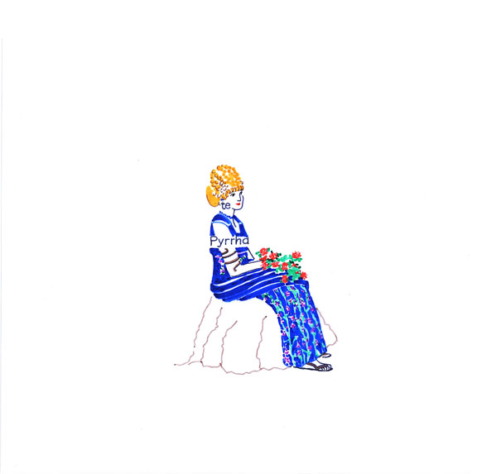
And where is the puer in relation to Pyrrha?
- in the poem as well as in the picture?

Slide 31


Slide 32
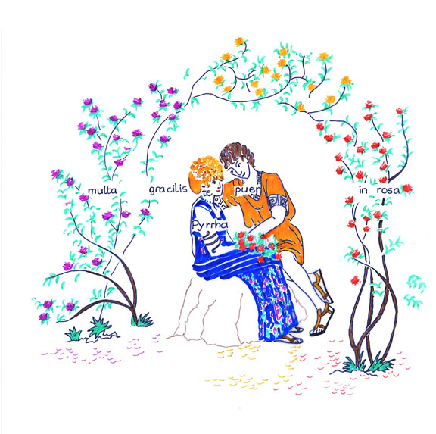

Slide 33
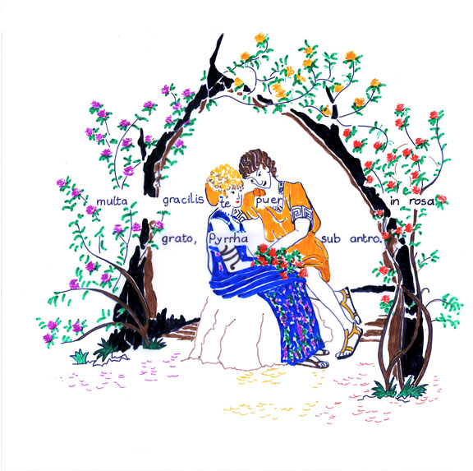

Slide 35
The positioning of the words illustrates the scene – concrete poetry!

Slide 36
Horace: Ars Poetica
line 361 UT PICTURA POESIS
Poetry is like a picture ….
line 242 TANTUM SERIES IUNCTURAQUE POLLET
Word-order and positioning has such great power
Pictorial approach to Latin poetry devised by Anne Dicks, creator of “Pyrrha’s Roman Pages” www.pyrrha.me.uk
Original art work by Di Lorriman.

